Slide 1

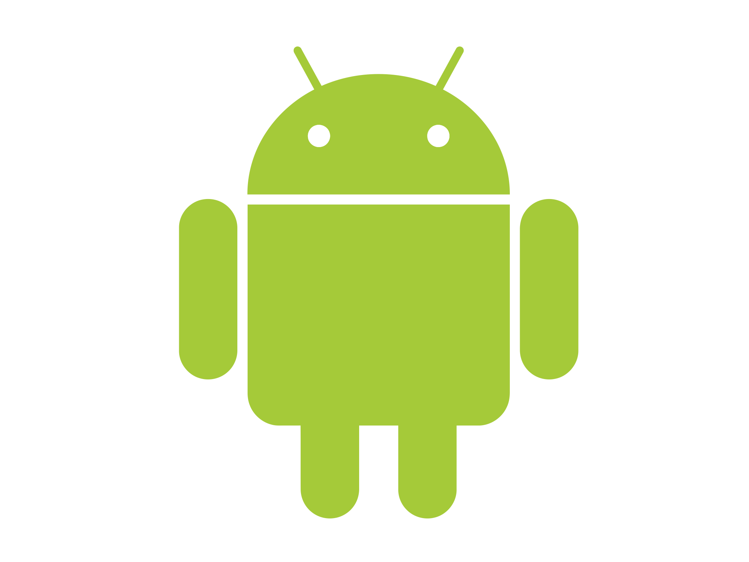
Android Application Development Workshop
Muhammad Azfar Siddiqui Associate Architect at 10Pearls

Slide 2
Why are you here?

Slide 3
The Juice
Overview
Hello World!
Fundamentals
Resources
Designing UI/UX
Notifying users
Data storage
Displaying data in lists
Integrating web services
Securing apps with ProGuard
Hands on development of a news app.

Slide 4
Overview
Android is a software stack for mobile devices that includes an operating system, middleware and key applications. Android powers more than one billion smart-phones, tablets, cars, watches, TVs etc
In 2005, Google acquired startup Android Inc. to start Android platform
The first commercial version, Android 1.0 was released in September 2008, along with its SDK
Android is under ongoing development by Google and the Open Handset Alliance (OHA)
Each released version corresponds to an API level

Slide 5
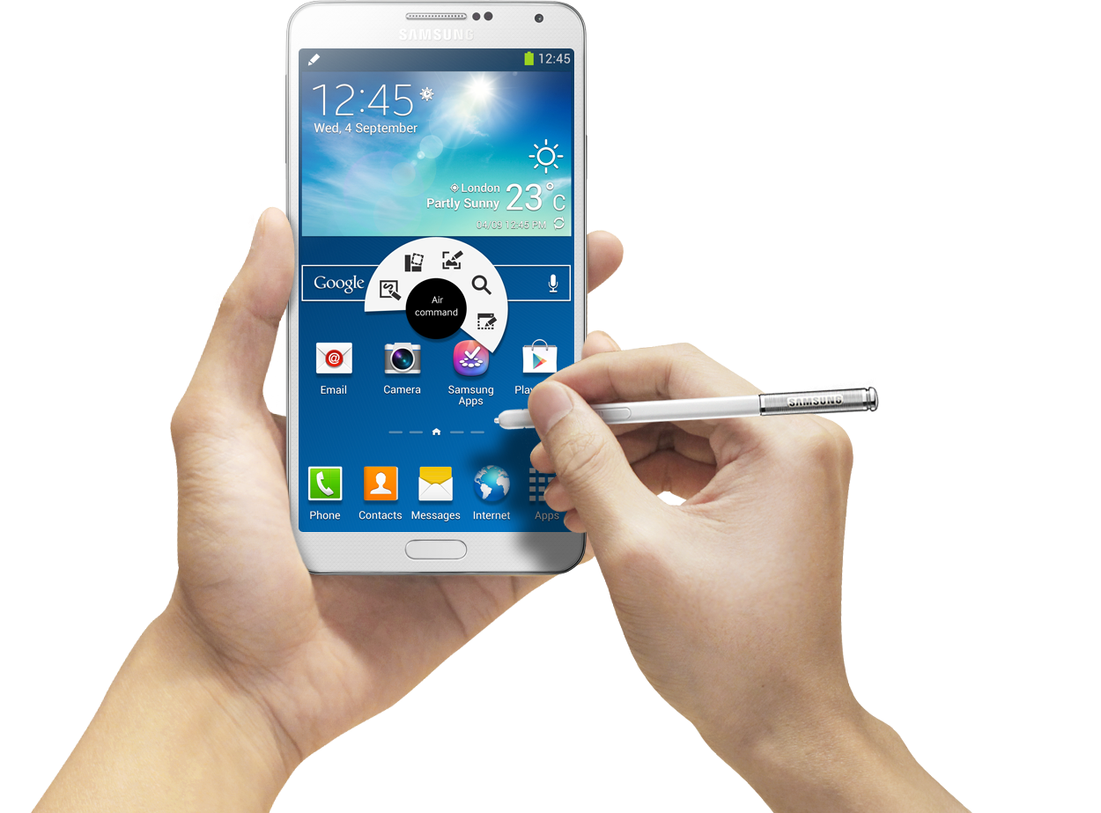
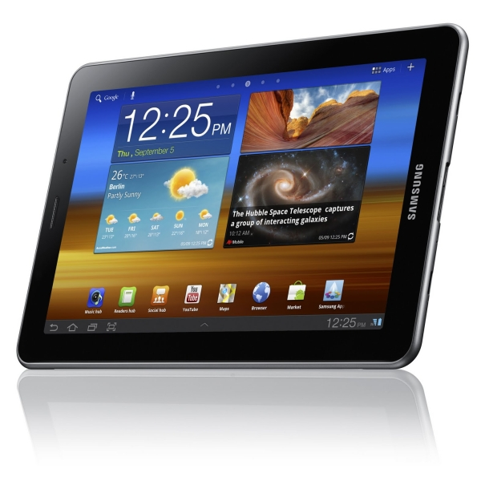
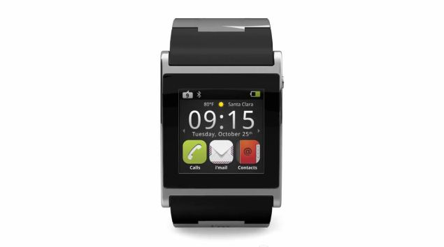
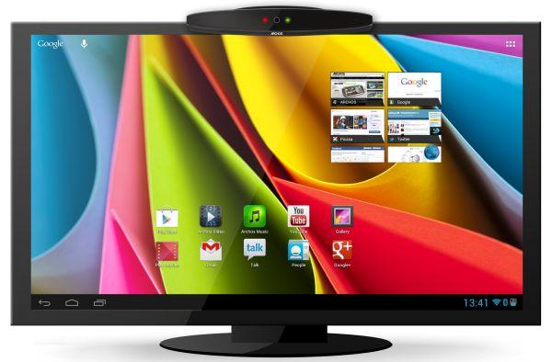
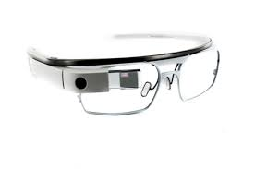
Android’s Playground

Slide 6
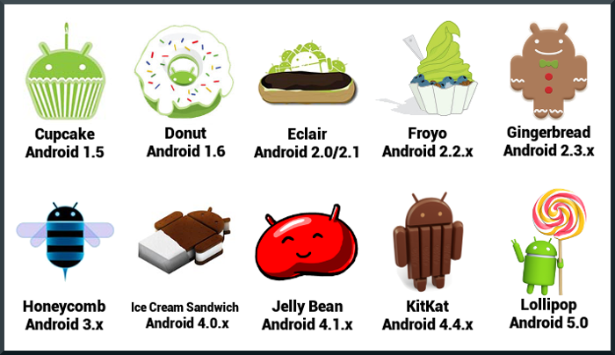
Major Releases

Slide 7
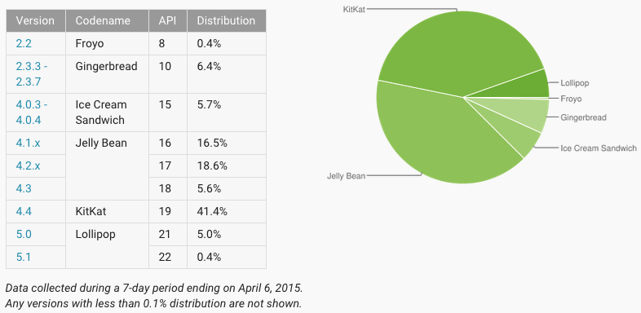
Version Trends

Slide 8
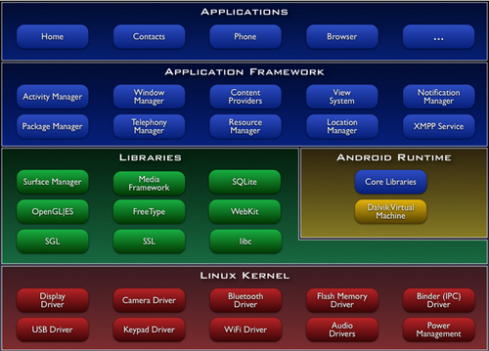
The Architecture

Slide 9
Developing for Mobile Advantages
Always with the user
Typically have Internet access
Typically GPS enabled
Typically have accelerometer & compass
Most have cameras & microphones
Notes:
May need to rearrange this slide.

Slide 10
Developing for Mobile Disadvantages
Limited screen size
Limited battery life
Limited processor speed
Limited storage
Limited, unreliable and sometimes slow network access
Range of platforms & configurations across devices

Slide 11
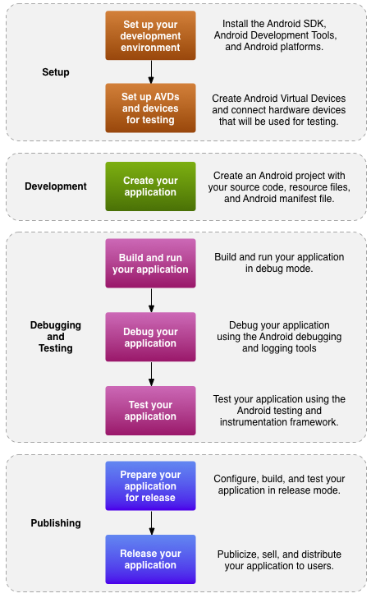
Dev. Workflow

Slide 12
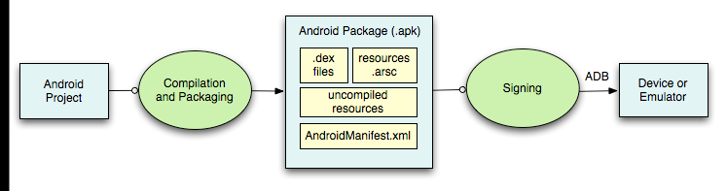
Behind the scenes
Android Debug Bridge (ADB) is a client server program that connects clients on developer machine to devices/emulators to facilitate development
APK is signed using debug keystore for development mode. For Play store builds, APK must be signed using the release keystore

Slide 13
Enough! Lets put our hands in dirt…
Run a Hello World app.
Have a look at the code structure

Slide 14
Fundamentals
Package
Main Thread
ANR
Activity
Intent
Fragment
Service
Content Provider
Broadcast Receiver

Slide 15
Package
Each application has a uniquely identifiable package name
The package name has to remain same across different update rollouts
Facebook was initially launched with package name com.facebook.katana. They now have to stick with it unwillingly
TempleRun rolled out the second version with a different package name, because they did not want users to lose access to version 1
Notes:
May need to rearrange this slide.

Slide 16
Main/UI Thread
When an application is launched, the system creates a thread of execution for the application, called "main.
This thread is very important because it is in charge of dispatching events to the appropriate user interface widgets
When your app performs intensive work in response to user interaction, this single thread model can yield poor performance
If everything is happening in the UI thread, performing long operations such as network access or database queries will block the whole UI
Notes:
May need to rearrange this slide.

Slide 17
Main/UI Thread continued… ANR
From the user's perspective, the application appears to hang
If the UI thread is blocked for more than a few seconds (about 5 seconds currently) the user is presented with the infamous "application not responding" (ANR) dialog. The user might then decide to quit your application and uninstall it if they are unhappy
Notes:
May need to rearrange this slide.

Slide 18
Activity
An activity represents a screen with a user interface
An Android application must have a launcher activity
Activity has lifecycle callback methods
Each activity must be registered in AndroidManifest.xml
Activity will typically use a layout XML file to use as the UI/UX
Lets have a look at an example
Notes:
May need to rearrange this slide.

Slide 19
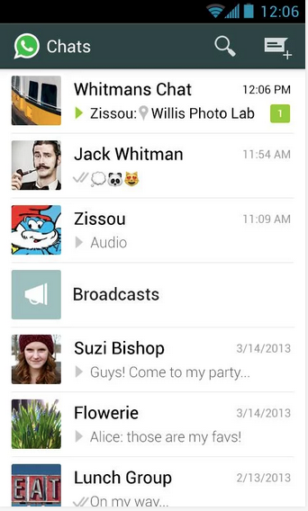
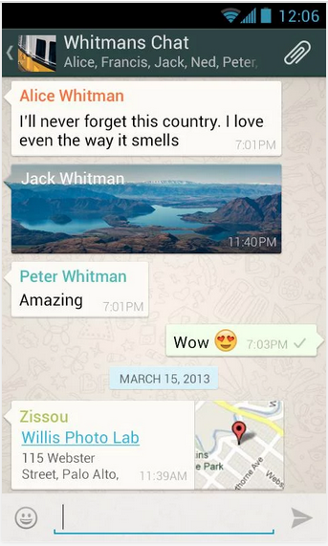
Activity example - WhatsApp
Notes:
May need to rearrange this slide.

Slide 20
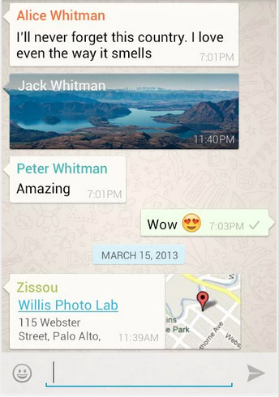
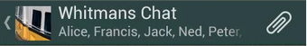
The Anatomy
Status Bar
List View
Action Bar
Notes:
May need to rearrange this slide.

Slide 21
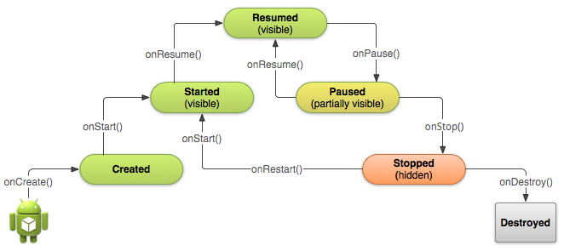
Activity Lifecycle
Notes:
May need to rearrange this slide.

Slide 22
Activity
Lets see it in action!
Notes:
May need to rearrange this slide.

Slide 23
Context
A context is a handle to the system
It provides services like resolving resources, obtaining access to databases and preferences, and so on
Android app has activities, it's like a handle to the environment your application is currently running in
Notes:
May need to rearrange this slide.

Slide 24
Intent
An Intent is exactly what it describes. It's an "intention" to do an action
Intents are asynchronous messages which allow application components to request functionality from other Android components
Its basically a message to say you want something to happen. Depending on the intent, apps or the OS might be listening for it and will react accordingly
An intent can contain data via a Bundle. This data can be used by the receiving component
Notes:
May need to rearrange this slide.

Slide 25
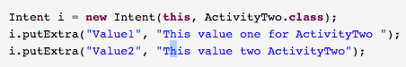
Explicit Intent
Explicit intents explicitly define the component which should be called by the Android system, by using the Java class as identifier
Notes:
May need to rearrange this slide.

Slide 26
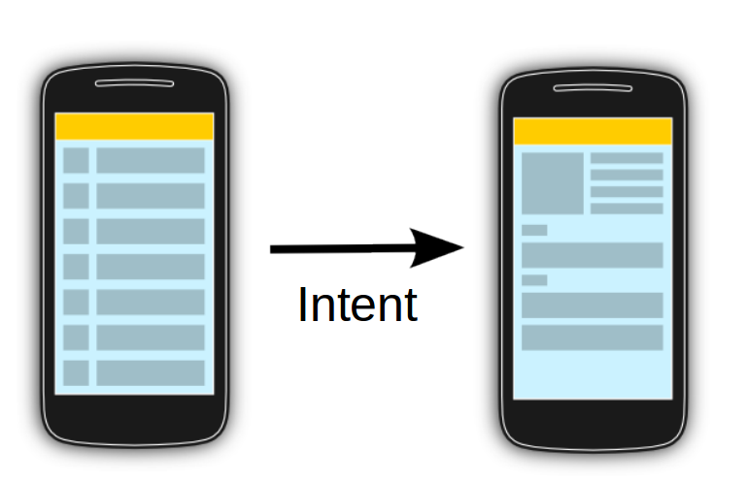
Explicit Intent
Notes:
May need to rearrange this slide.

Slide 27
Implicit Intent
Implicit intents specify the action which should be performed and optionally data which provides content for the action
Notes:
May need to rearrange this slide.

Slide 28
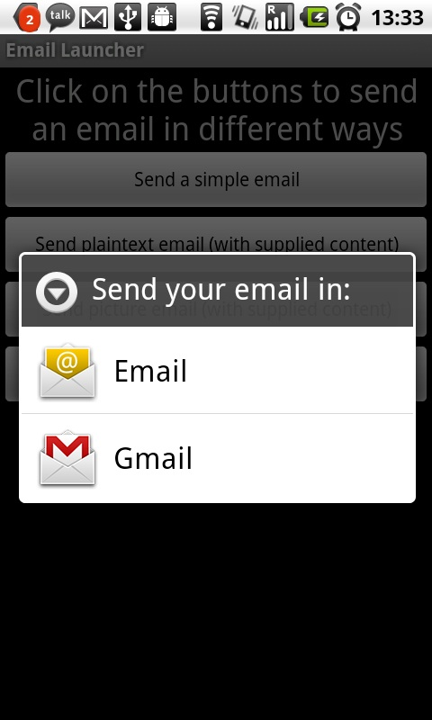
Implicit Intent
Notes:
May need to rearrange this slide.

Slide 29
Intent
Lets see it in action!
Notes:
May need to rearrange this slide.

Slide 30
Fragment
In short, it’s a sub-activity
A fragment is an independent Android component which can be used by an activity. A fragment encapsulates functionality so that it is easier to reuse within activities and layouts
A fragment runs in the context of an activity, but has its own life cycle and typically its own user interface
Fragments simplify the reuse of components in different layouts, e.g. you can build single-pane layouts for handsets (phones) and multi-pane layouts for tablets
Just like Activity, Fragment also has a lifecycle, quite similar to that of the former.
Notes:
May need to rearrange this slide.

Slide 31
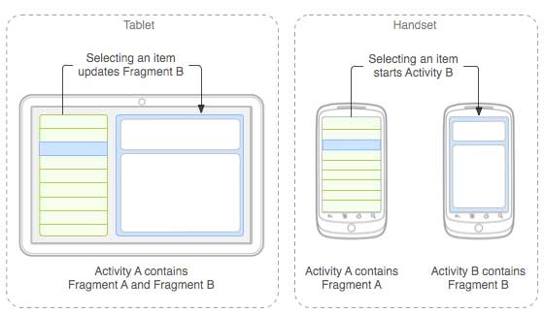
Fragment – Master detail
Notes:
May need to rearrange this slide.

Slide 32
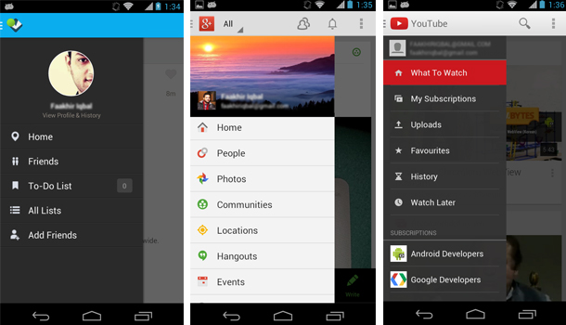
Fragment – Side menu UI pattern
Notes:
May need to rearrange this slide.

Slide 33
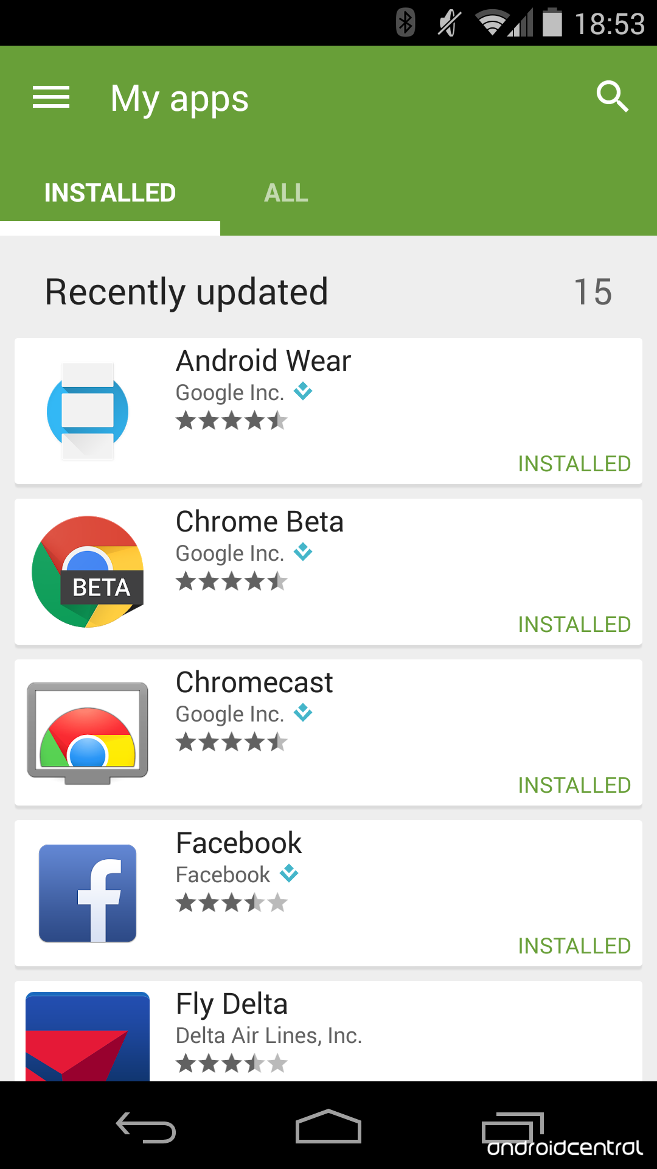
Fragment - Tabs
Notes:
May need to rearrange this slide.

Slide 34
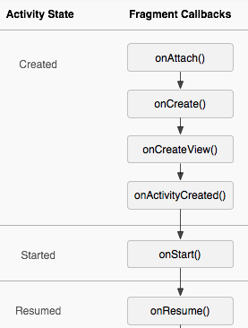
Fragment Lifecycle
Notes:
May need to rearrange this slide.

Slide 35
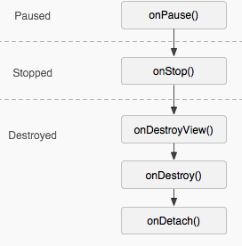
Fragment Lifecycle (cont.)
Notes:
May need to rearrange this slide.

Slide 36
Fragment
Lets see it in action!
Notes:
May need to rearrange this slide.

Slide 37
Content Provider
Content providers manage access to a structured set of data
Standard interface that connects data in one process with code running in another process
When you want to access data in a content provider, you use the ContentResolver object
You don't need to develop your own provider if you don't intend to share your data with other applications
Android itself includes content providers that manage data such as audio, video, images, and personal contact information
Notes:
May need to rearrange this slide.

Slide 38
Content Provider - Contacts
<Example>
Notes:
May need to rearrange this slide.

Slide 39
Content Provider
Lets see it in action!
Notes:
May need to rearrange this slide.

Slide 40
Service
A service is a component which runs in the background without direct interaction with the user
Services are used for repetitive and potentially long running operations, i.e., Internet downloads, checking for new data, data processing
By default, a service runs in the same process as the main thread of the application
Custom services are started from other Android components, i.e., activities, broadcast receivers and other services
The Service does not create its own thread and does not run in a separate process (unless you specify otherwise
Notes:
May need to rearrange this slide.

Slide 41
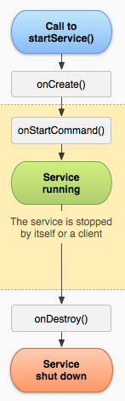
Its recommended to notify the user of the current state of the service. For example, If the service is expected to download a file or do a sync operation in background. The service must notify the user about the final outcome of the operation. If it passed, display a success message OR a retry option. Ideally, these messages should be shown in Status bar notifications OR via Toast message
Service Lifecycle
Notes:
May need to rearrange this slide.

Slide 42
Service Classes
Service: This is the base class for all services. When you extend this class, it's important that you create a new thread in which to do all the service's work, because the service uses your application's main thread, by default, which could slow the performance of any activity your application is running
IntentService: This is a subclass of Service that uses a worker thread to handle all start requests, one at a time. This is the best option if you don't require that your service handle multiple requests simultaneously. All you need to do is implement onHandleIntent(), which receives the intent for each start request so you can do the background work.
Notes:
May need to rearrange this slide.

Slide 43
Service
Lets see it in action!
Notes:
May need to rearrange this slide.

Slide 44
Broadcast Receiver
A broadcast receiver is an Android component which allows you to register for system or application wide events
For example, applications can register for the ACTION_BOOT_COMPLETED system event which is fired once the Android system has completed the boot process
When the event occurs, the ‘onReceive’ method of the implementing class is automatically fired
As of Android 3.1, in order for the broadcast receivers to get the intended events, an application has to be run by the user once after installing from the Play Store
Notes:
May need to rearrange this slide.

Slide 45
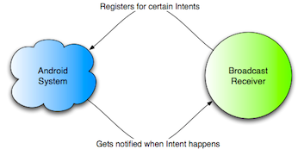
Broadcast Receiver
Notes:
May need to rearrange this slide.

Slide 46
Broadcast Receiver – System events
ACTION_BOOT_COMPLETED – Boot completed
ACTION_POWER_CONNECTED – Power got connected to the device
ACTION_BATTERY_LOW – Trigger on low memory ……………………… ……………………… A long list!
Notes:
May need to rearrange this slide.

Slide 47
Broadcast Receiver
Lets see it in action!
Notes:
May need to rearrange this slide.

Slide 48
Google Play Services
Overview
Maps
Location
Google+
Drive
Games
Ads
Wallet

Slide 49
Google Play Services
With Play services, your application can take advantage of the latest Google powered features like Maps, Location and more…
Updates to Play services are automatically pushed to all the devices through the Google Play store
Easy to use client libraries are provided for each service that let you implement the functionality you want
Notes:
May need to rearrange this slide.

Slide 50
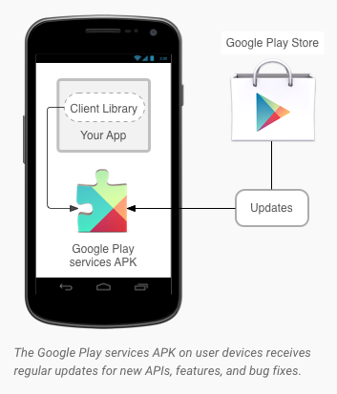
Google Play Services – OTA updates
Notes:
May need to rearrange this slide.

Slide 51
Google Play Services - Maps
Allow your users to explore the world with rich maps provided by Google. Identify locations with custom markers, augment the map data with image overlays, embed one or more maps as fragments, and much more
Notes:
May need to rearrange this slide.

Slide 52
Google Play Services - Location
The location APIs make it easy for you to build location-aware applications, without needing to focus on the details of the underlying location technology. The related Places APIs also help your app identify real-world points of interest near the user
Notes:
May need to rearrange this slide.

Slide 53
Google Play Services – Google+
The Google+ platform for Android lets you authenticate a user with the same credentials they use on Google every day. Once a user signs in with Google, you can create more engaging experiences and drive usage of your app.
Notes:
May need to rearrange this slide.

Slide 54
Google Play Services – Drive
Give your users access to their files, wherever they are, on any device. The Google Drive Android API makes it easier than ever to use Drive to store and sync user’s files between their mobile devices and the cloud. Simply use Drive like local file storage and the API will handle the syncing for you
Notes:
May need to rearrange this slide.

Slide 55
Google Play Services – Games
Give your users access to their files, wherever they are, on any device. The Google Drive Android API makes it easier than ever to use Drive to store and sync user’s files between their mobile devices and the cloud. Simply use Drive like local file storage and the API will handle the syncing for you
Notes:
May need to rearrange this slide.

Slide 56
Google Play Services – Ads
Monetize your app with banner or interstitial ads from Google's vast pool of advertisers. Integrate with top ad networks through mediation to maximize your revenue from impressions. Take advantage of new ad features and capabilities through Google Play services, without having to add or update a library in your APK
Notes:
May need to rearrange this slide.

Slide 57
Google Play Services – Wallet
Add fast, secure checkout for users buying physical goods and services from your app. Transactions are monitored for fraud 24/7. Keep your existing payments infrastructure and integrate Google Wallet quickly, easily and free of charge
Notes:
May need to rearrange this slide.

Slide 58
Resources
Key terminologies
Measurement units
Layouts
Drawables
Strings
Colors
Styles

Slide 59
Resources - Key terminologies
Screen size - Actual physical size, measured as the screen's diagonal. For simplicity, Android groups all actual screen sizes into four generalized sizes: small, normal, large, and extra-large.
Screen density - The quantity of pixels within a physical area of the screen; usually referred to as dpi (dots per inch). For example, a "low" density screen has fewer pixels within a given physical area, compared to a "normal" or "high" density screen.
Resolution - The total number of physical pixels on a screen. When adding support for multiple screens, applications do not work directly with resolution; applications should be concerned only with screen size and density, as specified by the generalized size and density groups.
Notes:
May need to rearrange this slide.

Slide 60
Measurement Units – dp/dip
Density independent Pixel
A virtual pixel unit that you should always use when defining UI layout to express layout dimensions or position in a density-independent way.
The density-independent pixel is equivalent to one physical pixel on a 160 dpi screen, which is the baseline density assumed by the system for a "medium" density screen. At runtime, the system transparently handles any scaling of the dp units, as necessary, based on the actual density of the screen in use
Android provides following screen densities:
ldpi (low) ~120dpi
mdpi (medium) ~160dpi
hdpi (high) ~240dpi
xhdpi (extra-high) ~320dpi
xxhdpi (extra-extra-high) ~480dpi
xxxhdpi (extra-extra-extra-high) ~640dpi
Notes:
May need to rearrange this slide.

Slide 61
Measurement Units – dp/dip
Your application achieves "density independence" when it preserves the physical size (from the user's point of view) of user interface elements when displayed on screens with different densities.
Maintaining density independence is important because, without it, a UI element (such as a button) appears physically larger on a low-density screen and smaller on a high-density screen. Such density-related size changes can cause problems in your application layout and usability
Notes:
May need to rearrange this slide.

Slide 62
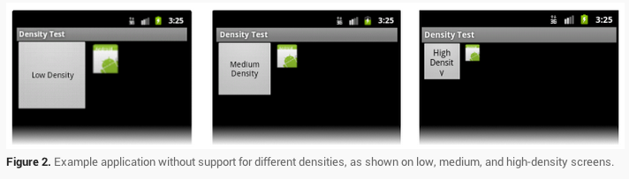
Measurement Units – dp/dip
A layout that is “not” density independent
Notes:
May need to rearrange this slide.

Slide 63
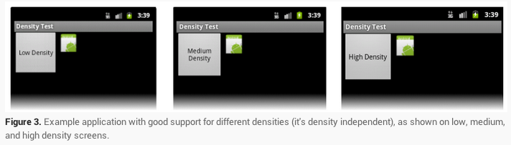
Measurement Units – dp/dip
A layout that is density independent
Notes:
May need to rearrange this slide.

Slide 64
Measurement Units – sp
Scale-independent Pixels - This is like the dp unit, but it is also scaled by the user's font size preference. It is recommend you use this unit when specifying font sizes, so they will be adjusted for both the screen density and the user's preference.
Notes:
May need to rearrange this slide.

Slide 65
Measurement Units – px
Pixel - Corresponds to actual pixels on the screen. This unit of measure is not recommended because the actual representation varies across devices; each devices may have a different number of pixels per inch and may have more or fewer total pixels available on the screen
Notes:
May need to rearrange this slide.

Slide 66
Layouts
A layout defines the visual structure for a user interface, such as the UI for an activity/fragment. You can declare a layout in two ways:
Declare UI elements in XML - Android provides a straight forward XML vocabulary that corresponds to the View classes and subclasses, such as those for widgets and layouts.
Instantiate layout elements at runtime - Your application can create View and ViewGroup objects (and manipulate their properties) programmatically.
Notes:
May need to rearrange this slide.

Slide 67


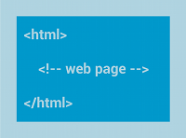
Layouts – Common types
LinearLayout- A layout that organizes its children into a single horizontal or vertical row. It creates a scrollbar if the length of the window exceeds the length of the screen
RelativeLayout- Enables you to specify the location of child objects relative to each other (child A to the left of child B) or to the parent (aligned to the top of the parent)
WebView– Displays web pages
Notes:
May need to rearrange this slide.

Slide 68


Layouts – Common types
ListView– Displays a scrolling single column list
GridView– Displays a scrolling grid of columns and rows
Notes:
May need to rearrange this slide.

Slide 69
Drawables
A drawable resource is a general concept for a graphic that can be drawn to the screen
Drawables are placed under res/drawable folder
You can retrieve with APIs such as getDrawable(int) or apply to another XML resource with attributes such as android:drawable, android:src and android:icon
Most common types of drawables are Bitmap drawable, Shape drawable, State list drawable
Notes:
May need to rearrange this slide.

Slide 70
Strings
String resources are used to store string messages/title, virtually any text that is used by the application
Usage of string resources is vital if the application needs to support multiple languages
You can define localized strings files e.g.:
res/values/strings.xml (for english strings) res/values-ar/strings.xml (for arabic strings) and so on…
Notes:
May need to rearrange this slide.

Slide 71
Colors
Application can define color values, by default in res/values/colors.xml
For example, the application may use a specific font color for section headers. Its best to define that color value in colors.xml to make future changes easier
Notes:
May need to rearrange this slide.

Slide 72
Styles
CSS like blocks to specify styling of a UI element, defined in res/values/styles.xml by default
For example, your application may have a consistent font style and formatting for section headers. You will not want to replicate same code on all layouts. Instead styles should be used to optimize future changes
Notes:
May need to rearrange this slide.

Slide 73
Resources
Lets see it in action!
Notes:
May need to rearrange this slide.

Slide 74
Designing UI/UX
Layout types
Built in views/controls

Slide 75
Notifying Users
Toast messages
Alert/Progress dialogs
Status bar notifications

Slide 76
Toast messages
A toast provides simple feedback about an operation in a small popup. It only fills the amount of space required for the message and the current activity remains visible and interactive.
For example, navigating away from an email before you send it triggers a "Draft saved" toast to let you know that you can continue editing later. Toasts automatically disappear after a timeout.
Notes:
May need to rearrange this slide.

Slide 77
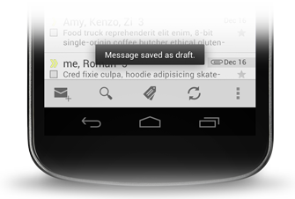
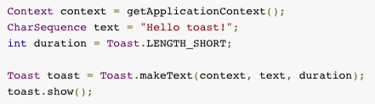
Toast messages
Notes:
May need to rearrange this slide.

Slide 78
Alert Dialogs
A dialog is a small window that prompts the user to make a decision or enter additional information. A dialog does not fill the screen and is normally used for modal events that require users to take an action before they can proceed.
Notes:
May need to rearrange this slide.

Slide 79
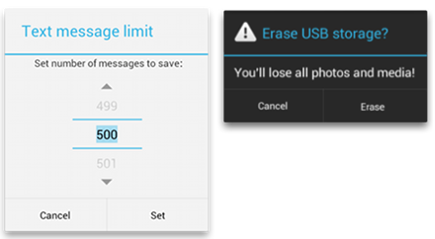
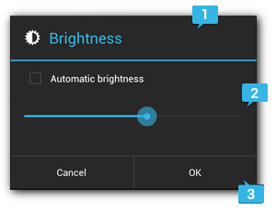
Alert Dialogs
Notes:
May need to rearrange this slide.

Slide 80
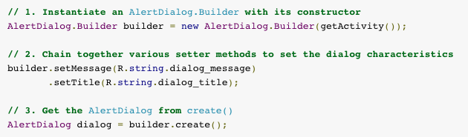
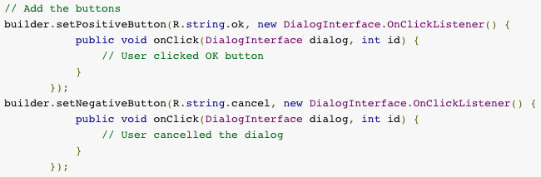
Alert Dialogs
Notes:
May need to rearrange this slide.

Slide 81
Status bar notifications
A notification is a message you can display to the user outside of your application's normal UI. When you tell the system to issue a notification, it first appears as an icon in the notification area
Notes:
May need to rearrange this slide.

Slide 82
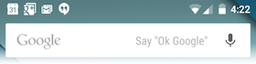
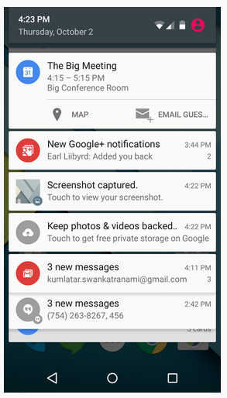
Status bar notifications
Notes:
May need to rearrange this slide.

Slide 83
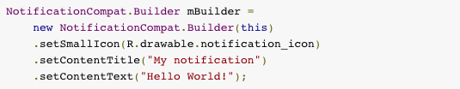
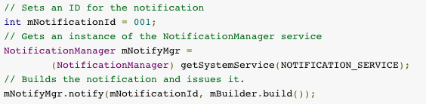
Status bar notifications
Building the notification
Issuing the notification
Notes:
May need to rearrange this slide.

Slide 84
Notifying users
Lets see it in action!
Notes:
May need to rearrange this slide.

Slide 85
Data Storage
Shared preferences
Internal storage
External storage
SQLite

Slide 86
Data Storage
Use Shared Preferences for primitive data
Use Internal device storage for private data
Use External storage for large data sets that are not private
Use SQLite databases for structured storage
Notes:
May need to rearrange this slide.

Slide 87
Data Storage
Android allows to persists application data via the file system. For each application the Android system creates a data/data/[application package] directory.
Use Shared Preferences for primitive data
Use Internal device storage for private data
Use External storage for large data sets that are not private
Use SQLite databases for structured storage
External storage is not private and may not always be available
Notes:
May need to rearrange this slide.

Slide 88
Shared Preferences
Android supports the usage of the SharedPreferences class for persisting key-value pairs (preferences) of primitive data types in the Android file system.
Example can be to store application specific settings.
A certain key value pair will persist in shared preferences until the application is uninstalled or that key is specifically deleted by Java code
By default, shared preferences are private to the application itself. However, permission mode can be set to keep them public (rarely used)
Notes:
May need to rearrange this slide.

Slide 89
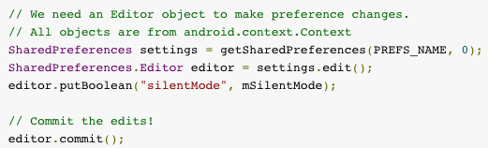
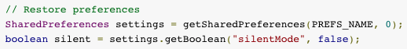
Shared Preferences
Writing:
Reading:
Notes:
May need to rearrange this slide.

Slide 90
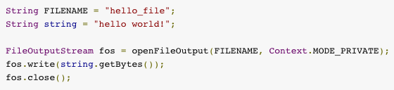
Internal storage
You can save files directly on the device's internal storage. By default, files saved to the internal storage are private to your application and other applications cannot access them (nor can the user). When the user uninstalls your application, these files are removed.
Notes:
May need to rearrange this slide.

Slide 91
External storage
Every Android-compatible device supports a shared "external storage" that you can use to save files. This can be a removable storage media (such as an SD card) or an internal (non-removable) storage. Files saved to the external storage are world-readable and can be modified by the user when they enable USB mass storage to transfer files on a computer
External storage can become unavailable if the user mounts the external storage on a computer or removes the media
In order to read or write files on the external storage, your app must acquire the READ_EXTERNAL_STORAGE or WRITE_EXTERNAL_STORAGE system permissions
Notes:
May need to rearrange this slide.

Slide 92
SQLite
Android provides full support for SQLite databases. Any databases you create will be accessible by name to any class in the application, but not outside the application
You can execute SQLite queries using the SQLiteDatabase query() methods, which accept various query parameters, such as the table to query, the projection, selection, columns, grouping, and others
Every SQLite query will return a Cursor that points to all the rows found by the query. The Cursor is always the mechanism with which you can navigate results from a database query and read rows and columns
The Android SDK includes a sqlite3 database tool that allows you to browse table contents, run SQL commands, and perform other useful functions on SQLite databases
Notes:
May need to rearrange this slide.

Slide 93
Data storage
Lets see it in action!
Notes:
May need to rearrange this slide.

Slide 94
Displaying dynamic data
Overview
Adapter
ListView
GridView

Slide 95
Overview
Android provides controls to arrange dynamic data in the form of lists or grids.
These controls use view recycling technique in order to optimize the rendering when the list/grid is displayed or scrolled
Items from the list can be removed/re-arranged/added at runtime
Notes:
May need to rearrange this slide.

Slide 96
Adapter
An Adapter object acts as a bridge between an AdapterView and the underlying data source for that view
Provides access to the data items
Also responsible for making a View for each item in the data set
Notes:
May need to rearrange this slide.

Slide 97
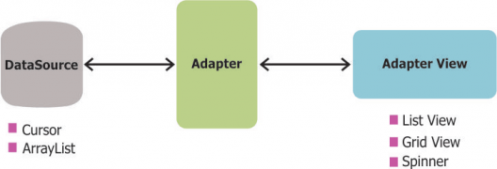
Adapter
Notes:
May need to rearrange this slide.

Slide 98
ListView
ListView is a control that displays a vertical list of scrollable items
The list items are automatically inserted to the list using an Adapter that pulls content from a source such as an array or database query and converts each item result into a view that's placed into the list
Notes:
May need to rearrange this slide.

Slide 99
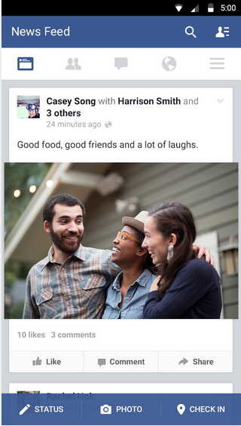
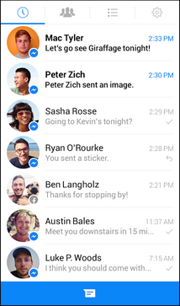
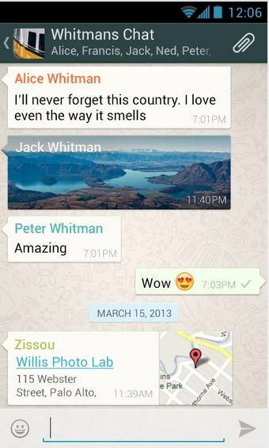
ListView
Notes:
May need to rearrange this slide.

Slide 100
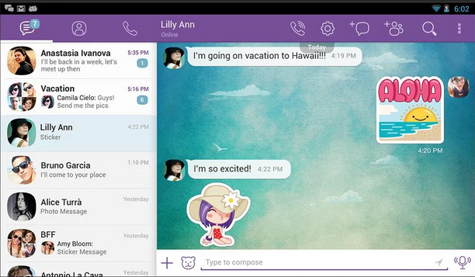
ListView
Notes:
May need to rearrange this slide.

Slide 101
GridView
GridView is a control that displays items in a two-dimensional, scrollable grid. The grid items are automatically inserted to the layout using a ListAdapter
Notes:
May need to rearrange this slide.

Slide 102
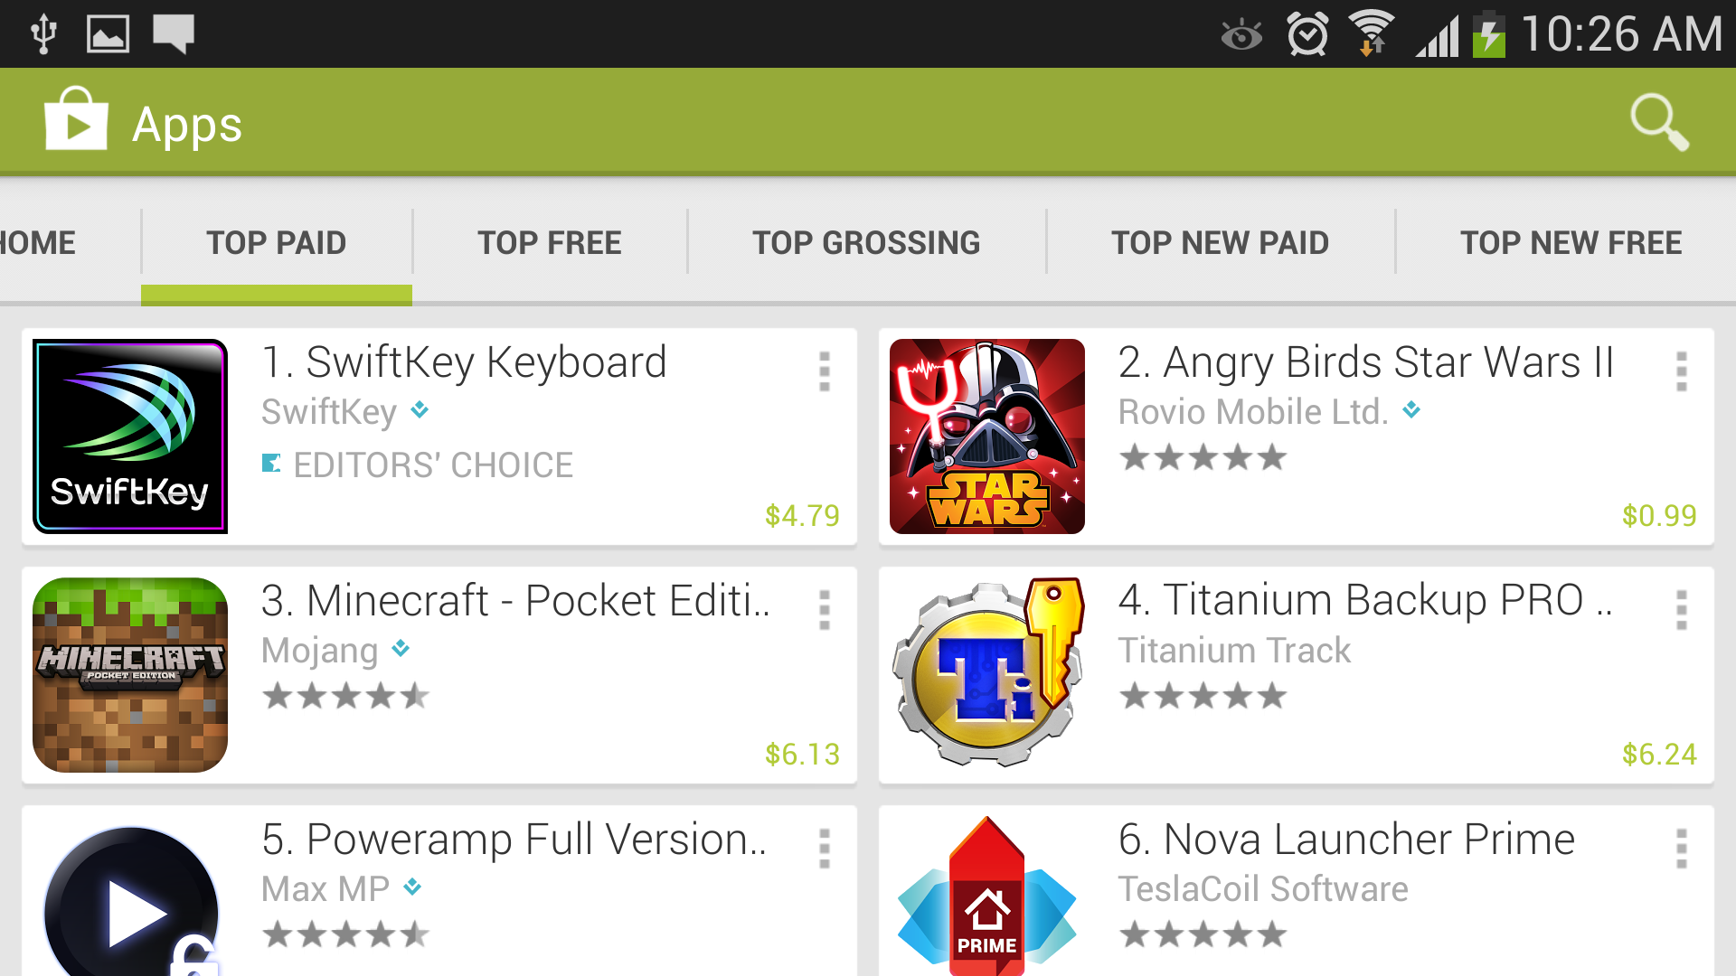
GridView
Notes:
May need to rearrange this slide.

Slide 103
Displaying dynamic data
Lets see it in action!
Notes:
May need to rearrange this slide.

Slide 104
Integrating web services
Overview
Using Volley framework
Gson

Slide 105
Overview
Most real world applications will talk with the cloud to store & retrieve data
This communication between client app and web server takes place through an API/web service layer
Android’s native HTTP clients are bad!
Notes:
May need to rearrange this slide.

Slide 106
Volley
You are lucky to have Volley!
It is an HTTP library that makes networking for Android apps easier and most importantly, faster
Volley frees you from writing boilerplate code and allows you to concentrate on the logic that is specific to your app
Notes:
May need to rearrange this slide.

Slide 107
Volley
Automatic scheduling of network requests
Multiple concurrent network connections
Transparent disk and memory response caching with standard HTTP cache coherence
Support for request prioritization
Cancellation request API
Ease of customization. For example, for retry and backoff
Notes:
May need to rearrange this slide.

Slide 108
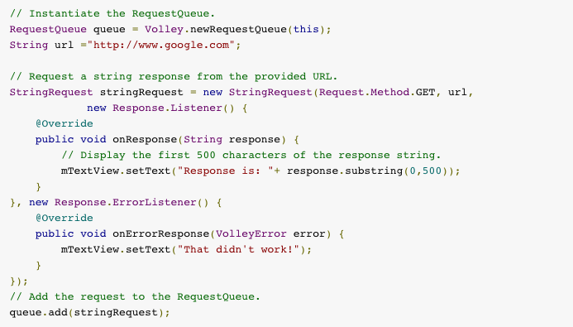
Volley – Sample request
Notes:
May need to rearrange this slide.

Slide 109

Volley – Request cancelation
To cancel a request, call cancel() on your Request object. Once cancelled, Volley guarantees that your response handler will never be called. What this means in practice is that you can cancel all of your pending requests in your activity's onStop() method.
Notes:
May need to rearrange this slide.

Slide 110
Gson
Gson is a Java library that can be used to convert Java Objects
into their JSON representation. It can also be used to convert
JSON string to an equivalent Java object.
Provide simple toJson() and fromJson() methods to convert Java objects to JSON and vice-versa
Extensive support of Java Generics
Allow custom representations for objects
Support arbitrarily complex objects (with deep inheritance hierarchies and extensive use of generic types)
Notes:
May need to rearrange this slide.

Slide 111
Integrating web services
Lets see it in action!
Notes:
May need to rearrange this slide.

Slide 112
Its Show Time!
Lets write some live code to create an application which:
Fetches news from a web service
Parses news JSON into POJOs
Displays a ListView that contains the fetched items with a pull to refresh UI paradigm

Slide 113
Securing apps with ProGuard
Background
Overview

Slide 114
Background
Your APK is open for the entire world!
Anyone with the knowledge of a couple of tools can completely get hold of your source code
Looking at the code, the malicious person can unearth sensitive data & logics in your code
Notes:
May need to rearrange this slide.

Slide 115
ProGuard
It’s a code obfuscator
The ProGuard tool shrinks, optimizes, and obfuscates your code by removing unused code and renaming classes, fields, and methods with semantically obscure names
The result is a smaller sized .apk file that is more difficult to reverse engineer
ProGuard runs only when you build your application in release mode
Notes:
May need to rearrange this slide.

Slide 116
ProGuard
Do NOT use reflection to access properties of objects or to invoke methods dynamically. ProGuard will obfuscate its name at runtime and your code will crash
Notes:
May need to rearrange this slide.

Slide 117

ProGuard
ProGuard can be enabled as shown below. By enabling minifyEnabled property
Notes:
May need to rearrange this slide.

Slide 118
ProGuard
Let’s see it in action!
Notes:
May need to rearrange this slide.

